Slide 1
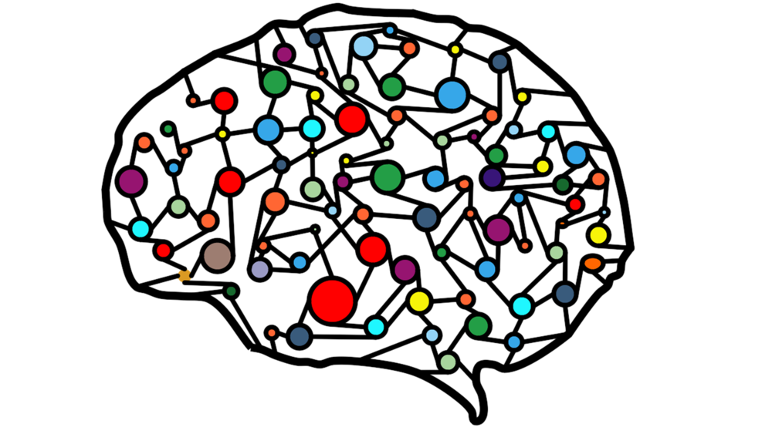

Computational Neuronal Dynamics
Emma Chameau
4960653
2025
From single neurons to networks and models of cognition

Slide 2





Why do computational neuroscience?
Easy hypothesis testing;
Fewer ethical concerns
Fewer technical limitations
Fewer costs
Integration of highly interconnected, complex neural networks
Integration of (pre-existing) datasets and collaboration
Understanding the fundamental principles of the brain
Control and reproducibility
Martınez-Canada, P., Ness, T. V., Einevoll, G. T., Fellin, T., and Panzeri, S. (2021). Computation of the electroencephalogram (eeg) from network models of point neurons. PLOS Computational Biology, 17(4):e1008893
Markram et al., (2015). Reconstruction and simulation of neocortical microcircuitry. Cell, 163(2):456–492.
Detorakis, G. I. and Rougier, N. P. (2012). A neural field model of the somatosensory cortex: Formation, maintenance and reorganization of ordered topographic maps. PLoS ONE, 7(7):e40257.
Borges, F. S., Moreira, J. V. S., Takarabe, L. M., Lytton, W. W., and Dura-Bernal, S. (2022). Large-scale biophysically detailed model of somatosensory thalamocortical circuits in netpyne. Frontiers in Neuroinformatics, 16
Notes:
Simulations provide a highly controlled environment where all parameters can be precisely set and manipulated.
Unlike experiments, which can be affected by biological variability computational models allow reproducible and systematic testing of hypotheses.
Identifies general computational principles underlying perception, memory, and learning.
To start off; why even do computational neuroscience?
First of all, it allows for the integration of highly interconnected, complex neural networks.
It facilitates hypothesis testing, as there are fewer ethical concerns, fewer technical limitations and fewer costs.
It also allows for the integration of pre-existing datasets for large scale modelling and also eases collaboration.
Its predictive power enables the detection of new disease markers when simulating and comparing diagnostic imaging outcomes.
And lastly, it allows for easy variable and parameter isolation.

Slide 3
Table of contents
01
02
05
Single neuron models
03
04
Integrate and Fire (IF) models
Leaky IF
Exponential IF
Adaptive Exponential
The passive cable equation
Literature implementation
The Hodgkin & Huxley model
06
07
Network of LIF neurons
Spatial working memory
Perceptual decision making
Network models
Notes:
Let’s move on to the contens of this presentation.
I will start with single neuron models, in which i will showcase different IF models, spatial models in dendrites and the passive cable equation, an implementation from literature and the hodgkin and huxley model.
In the second part I will present different network models and some of their applications.

Slide 4
Single neuron models

Slide 5
01
Integrate-and-Fire (IF) Models

Slide 6
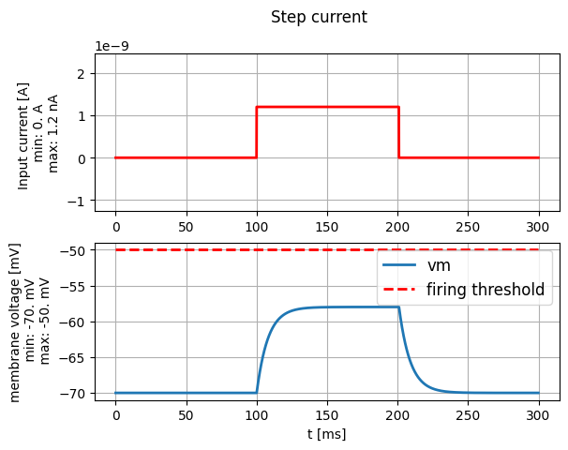
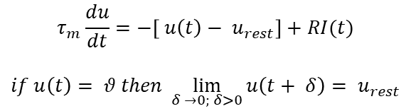
Leaky IF Model
$$τ_{m}\frac{du}{dt}=−\left[ u\left(t\right)− u_{rest}\right]+RI(t)$$
$$if u\left(t\right)= θ then \lim_{δ →0; δ>0}{u\left(t+ δ\right)= u_{rest}}$$
The model is reduced to
A linear differential equation
A threshold for spiking
Action potentials (AP) have roughly the same form: information is transferred in the presence or absence of a spike

Slide 7
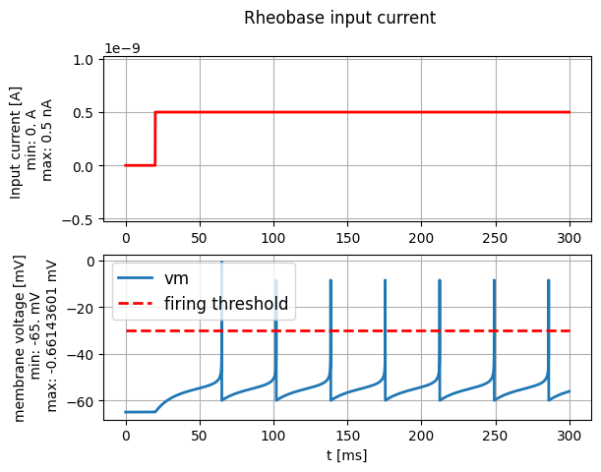
Leaky IF model
The model is reduced to
A linear differential equation
A threshold for spiking
Action potentials (AP) have roughly the same form: information is transferred in the presence or absence of a spike
Reduces spikes to events
Exponential IF model
Extension of the Leaky IF model
Exponential term allows for smooth spike initiation
Higher biological realism

Slide 8
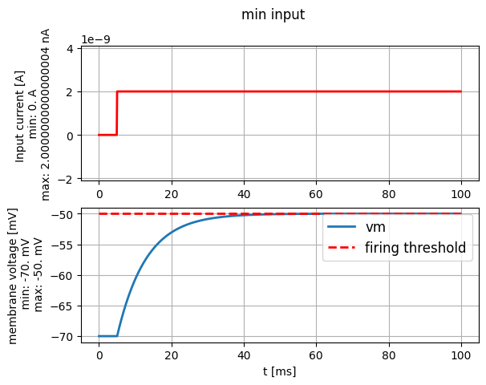
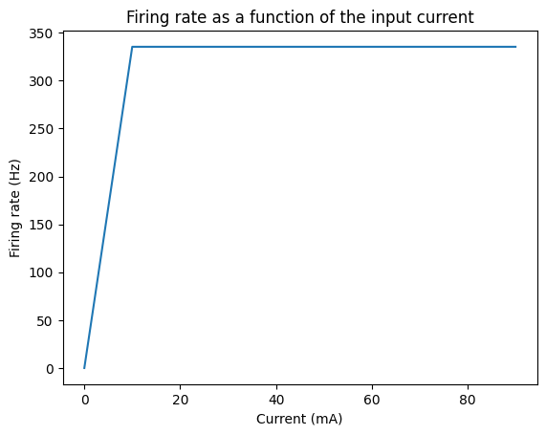

Slide 9
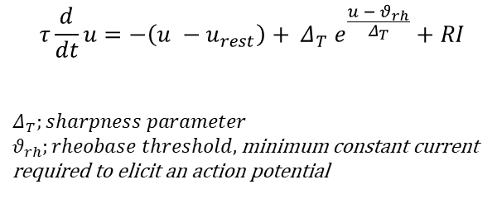
Exponential IF Model
$$τ\frac{d}{dt}u=−\left(u −u_{rest}\right)+ Δ_{T} e^{\frac{u − θ_{rh}}{Δ_{T}}}+RI$$
$$Δ_{T};sharpness parameter$$
$θ_{rh};rheobase threshold,$minimum constant current required to elicit an action potential
exponential term
Extension of the Leaky IF model
Exponential term allows for smooth spike initiation
Higher biological realism

Slide 10
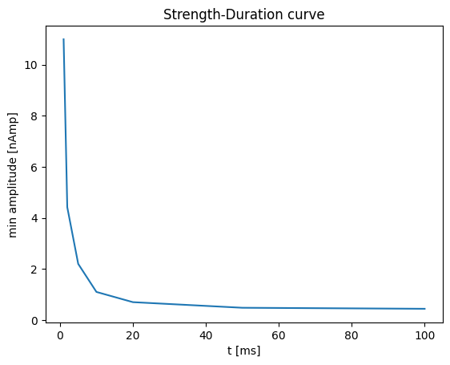
The minimal amplitude to elicit a spike depends on the duration of the current.
At short durations, a high current is required to generate a spike.
At long durations, a lower current suffices, eventually reaching a constant minimum threshold (rheobase current)

Slide 11
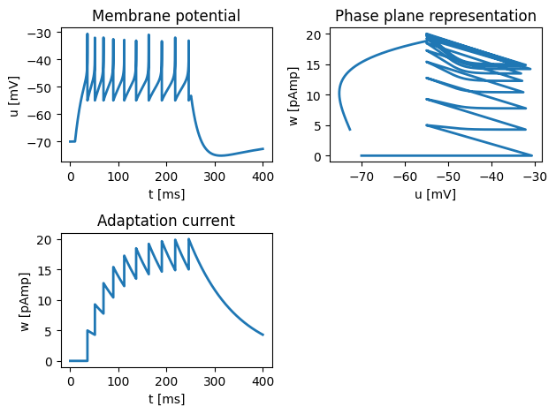
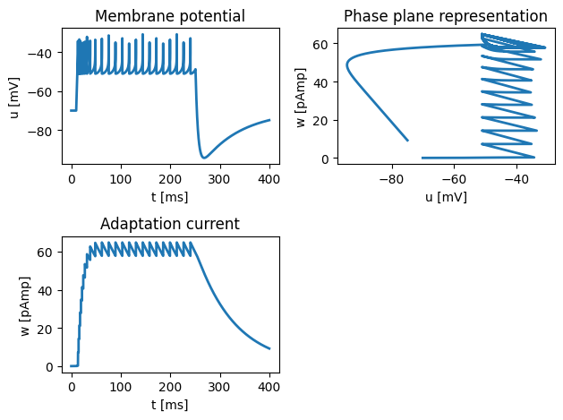
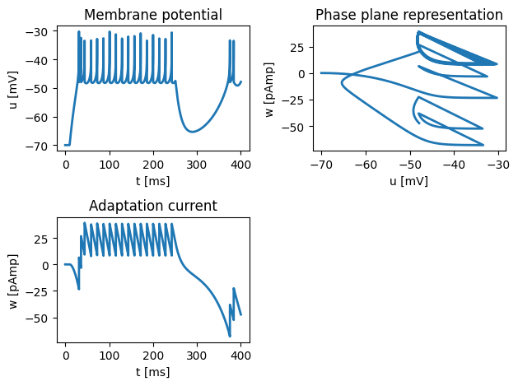
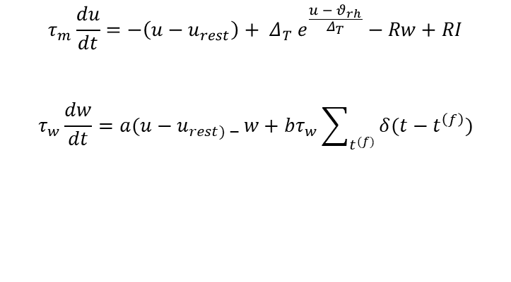
AdEx: Adaptive Exponential IF Model
Adapting
$$τ_{m}\frac{du}{dt}=−\left(u−u_{rest}\right)+ Δ_{T} e^{\frac{u − θ_{rh}}{Δ_{T}}}−Rw+RI$$
$$τ_{w}\frac{dw}{dt}=a(u−u_{rest) − }w+bτ_{w}\sum_{t^{(f)}}{δ(t−t^{\left(f\right)})}$$
Adaptation current
(Initial) Bursting
Further extension of the EIF model
Standard IF models do not capture how neurons change their firing over time
Adaptation current (w) allows model to reproduce various biologically realistic firing patterns
Irregular
Notes:
More Realistic Than Simple IF Models: Standard integrate-and-fire models do not capture how neurons change their firing over time.

Slide 12
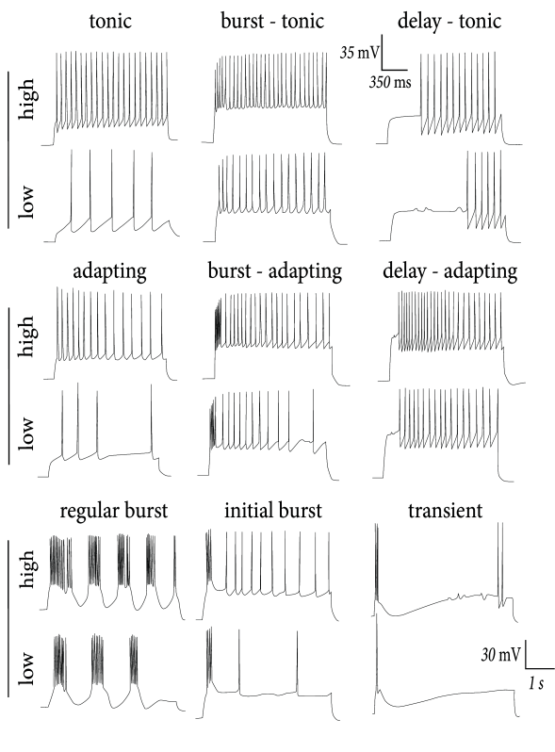
AdEx: Adaptive Exponential IF Model
$$τ_{m}\frac{du}{dt}=−\left(u−u_{rest}\right)+ Δ_{T} e^{\frac{u − θ_{rh}}{Δ_{T}}}−Rw+RI$$
$$τ_{w}\frac{dw}{dt}=a(u−u_{rest) − }w+bτ_{w}\sum_{t^{(f)}}{δ(t−t^{\left(f\right)})}$$
Adaptation current
Further extension of the EIF model
Standard IF models do not capture how neurons change their firing over time
Adaptation current (w) allows model to reproduce various biologically realistic firing patterns
Notes:
More Realistic Than Simple IF Models: Standard integrate-and-fire models do not capture how neurons change their firing over time.

Slide 13
Spiking pattern recreation
Adapting
Irregular
(Initial) Bursting

Slide 14
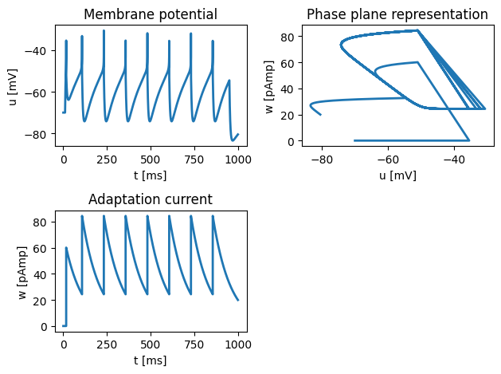
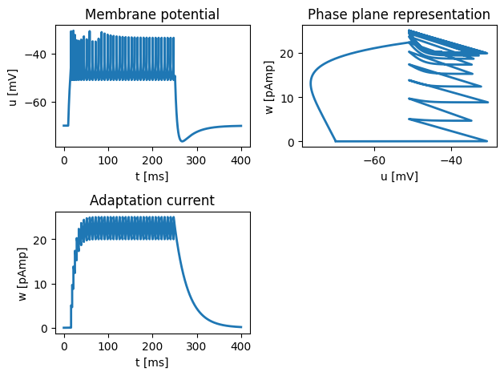
$$τ_{m}\frac{du}{dt}=−\left(u−u_{rest}\right)+ Δ_{T} e^{\frac{u − θ_{rh}}{Δ_{T}}}−Rw+RI τ_{w}\frac{dw }{dt}=a(u−u_{rest) − }w+bτ_{w}\sum_{t^{(f)}}{δ(t−t^{\left(f\right)})}$$
For a small a;
A large jump b and a large time scale tau_w
A small jump b and a small time scale tau_w
1
a; subthreshold adaptation
b; spike-frequency adaptation
tau_w; time constant
2

Slide 15
02
The passive cable equation

Slide 16
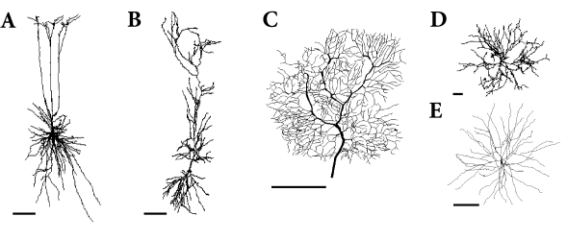
The passive cable equation
Includes spatial structure of the neuron
The passive cable equation describes how electric signals passively propagate along a neuron’s dendrites and axons
Spatial and temporal decay of signals
Dendritic trees

Slide 17
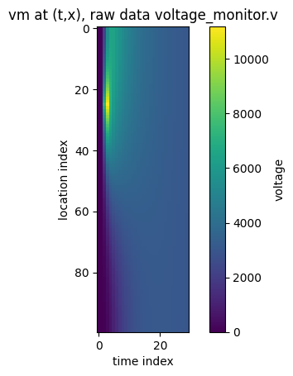
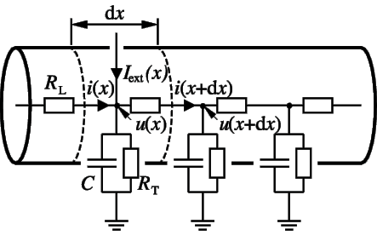
Cable equation: Part of a dendrite and the corresponding circuit diagram.
Cable of length 800um; injection of a 0.1 ms long step current of amplitude 0.8 nA at 1ms, x=200um

Slide 18
Vm at (x, t)
Cable of length 800um; injection of a 0.1 ms long step current of amplitude 0.8 nA at 1ms, x=200um

Slide 19
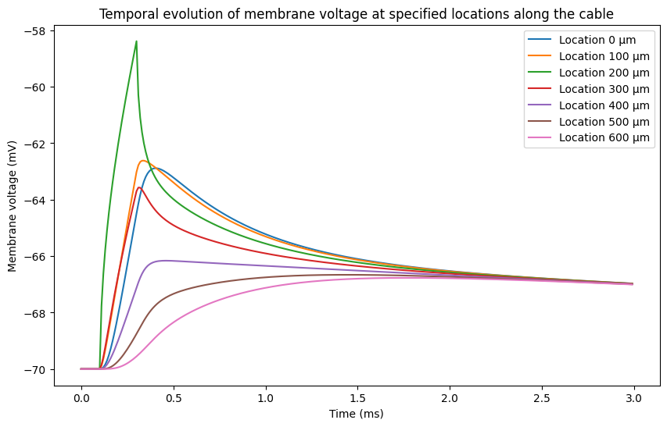
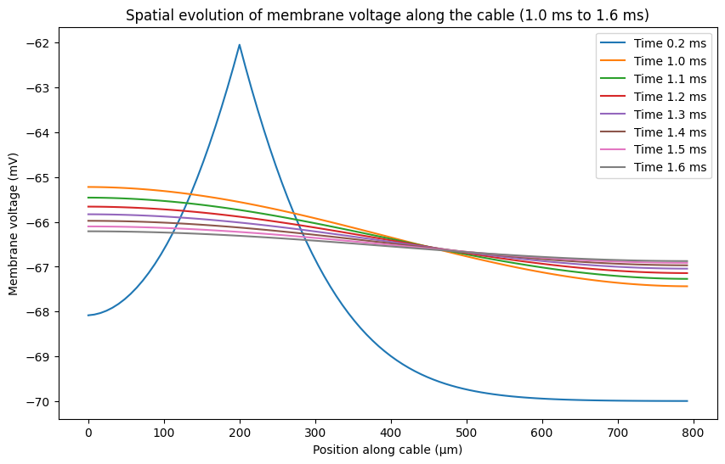
Injection of a 0.1 ms long step current of amplitude 0.8 nA at 0ms, x=200um
200 um
t = 0 ms
200 um
t = 0 ms

Slide 20
Figure slide
Notes:
animation

Slide 21
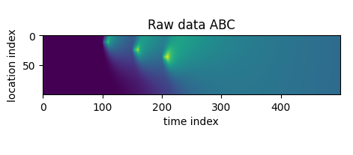
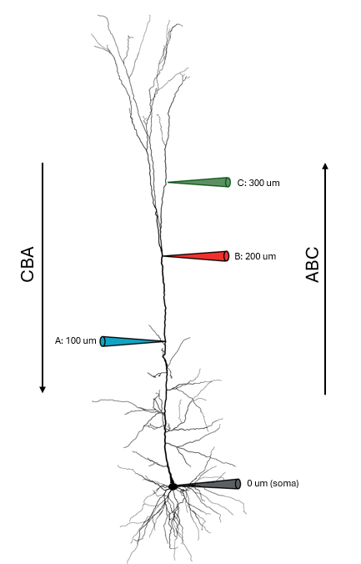
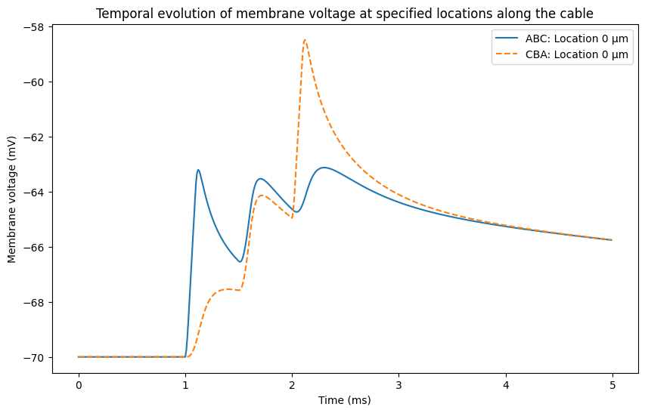

Slide 22
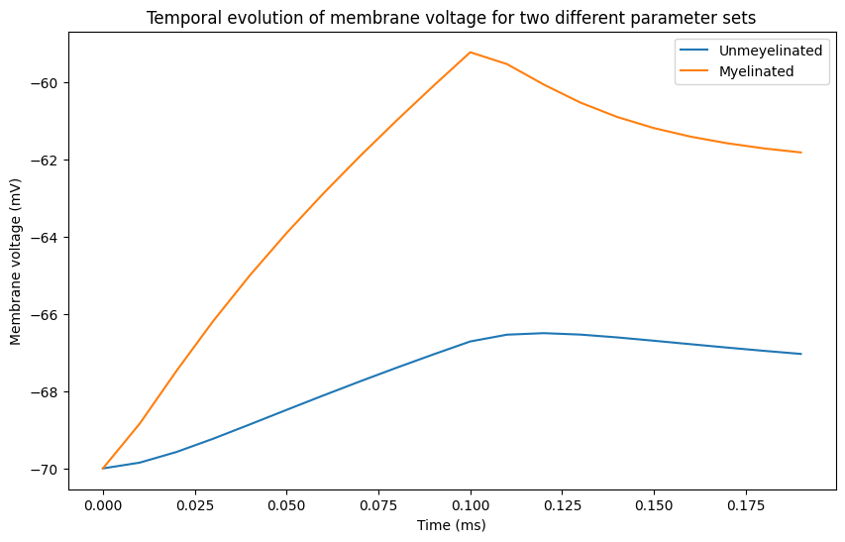
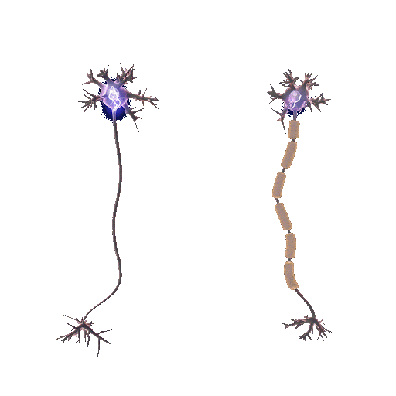

Slide 23
03
Literature Implementation

Slide 24
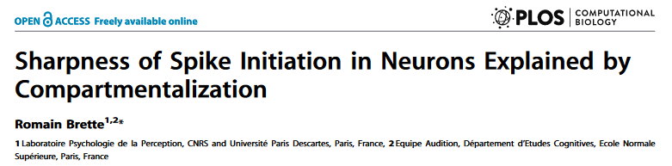
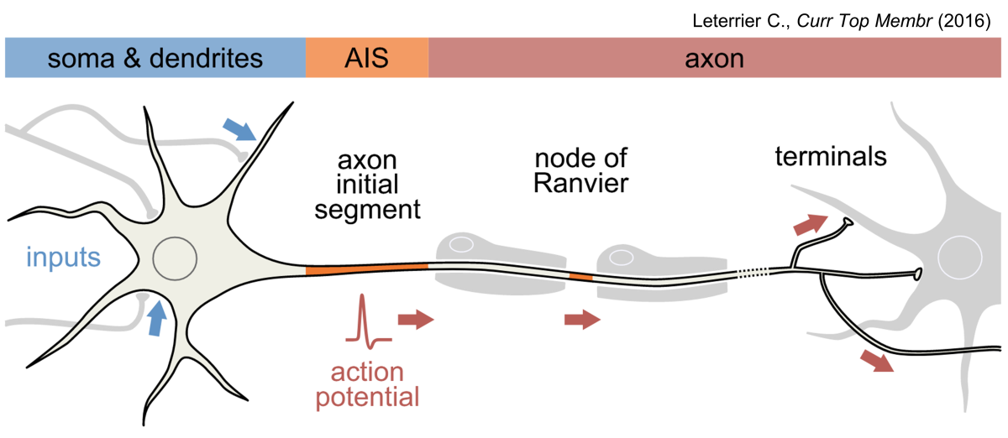
APs are initiated at the axon initial segment (AIS), where voltage-gated Na channels open.
Na channels should open gradually with depolarization.
However, spikes recorded at the soma appear much sharper than expected.
Traditional explanation: The spike is initiated in the axon and actively backpropagated to the soma, which sharpens its appearance.
New hypothesis: The sharpness of spike initiation is due to the compartmentalization of spike initiation, not just backpropagation
Why do spikes appear so abrupt at the soma, even though sodium channels open gradually according to biophysical principles?

Slide 25
Ball-and-stick model; distinct physical separation between soma and axon
Why do spikes appear so abrupt at the soma, even though sodium channels open gradually according to biophysical principles?
New hypothesis: The sharpness of spike initiation is due to compartmentalization of the neuron
AIS
Na+ channels
~10-40 µm
soma
axon
Notes:
The author simulated a "ball-and-stick" model (soma + thin axon) to analyse how Na+ activation changes based on the distance of Na+ channels from the soma

Slide 26
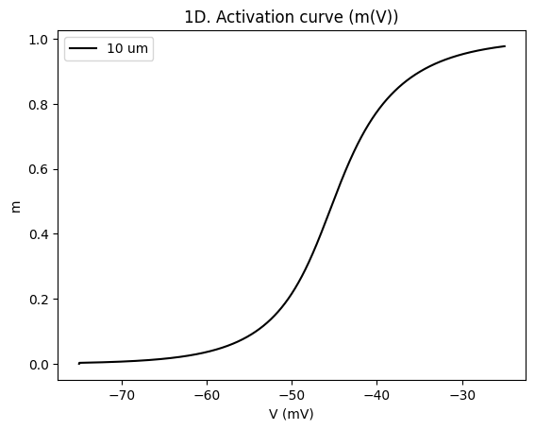
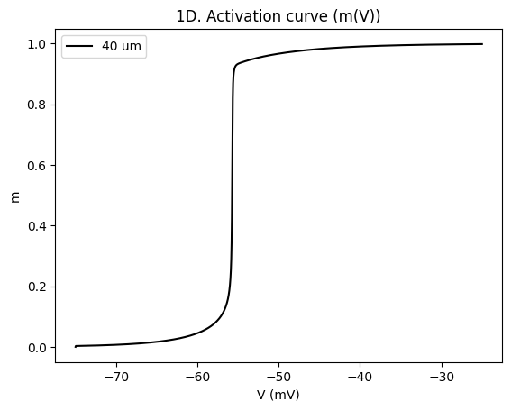
Na+ channels
10 µm
Na+ channels
40 µm

Slide 27
Ball-and-stick model; distinct physical separation between soma and axon
When Na channels are placed at a distance of 27- 40 µm from the soma, the soma acts as a current sink.
This leads to an instability where Na channels open suddenly rather than gradually.
Na+ channels
~27-40 µm
soma
axon

Slide 28
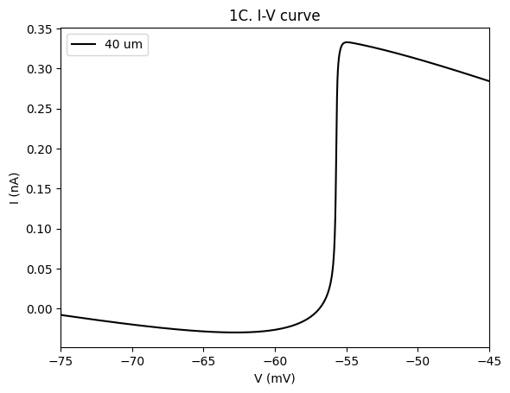
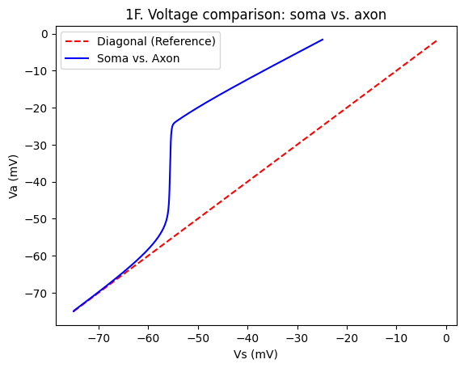

Slide 29
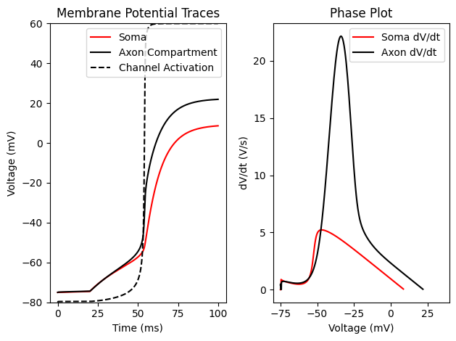

Slide 30
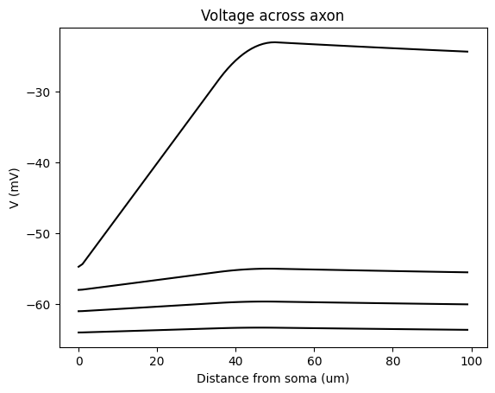
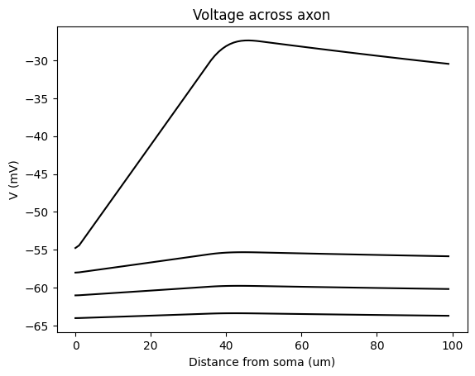
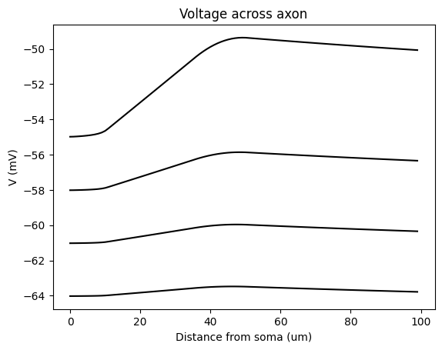
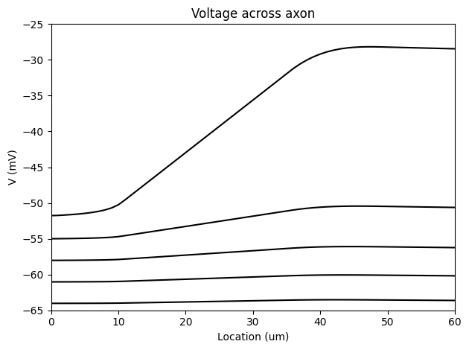

Slide 31
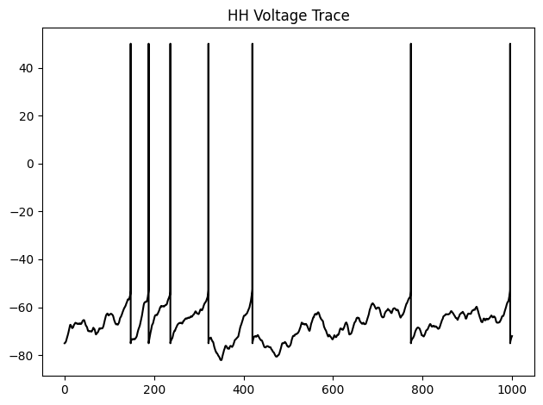
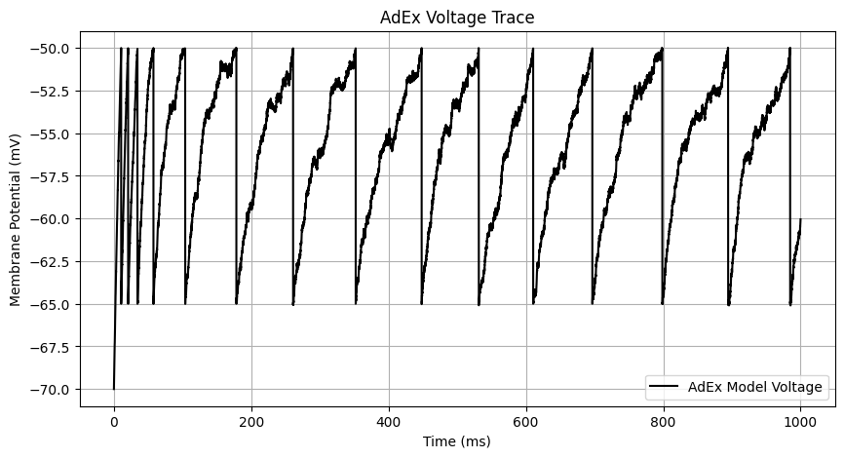
Comparison to IF model

Slide 32
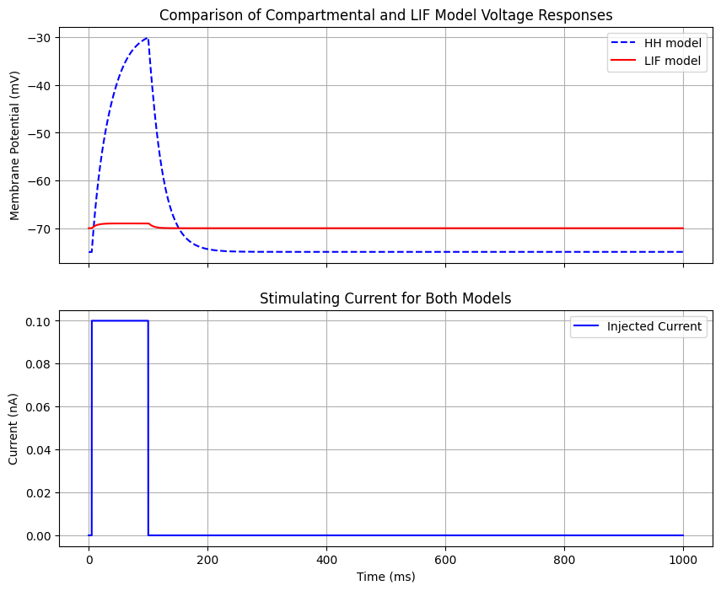
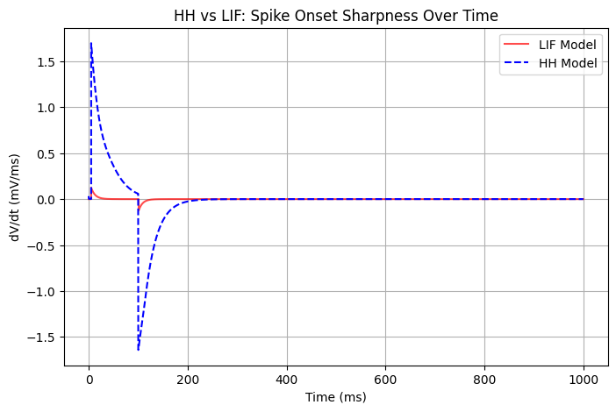

Slide 33
04
The Hodgkin & Huxley (HH) model

Slide 34
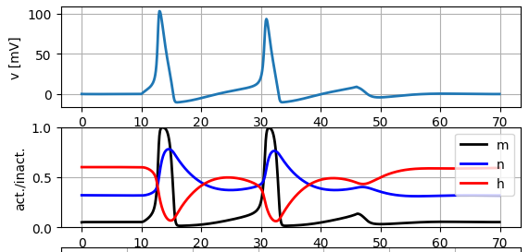
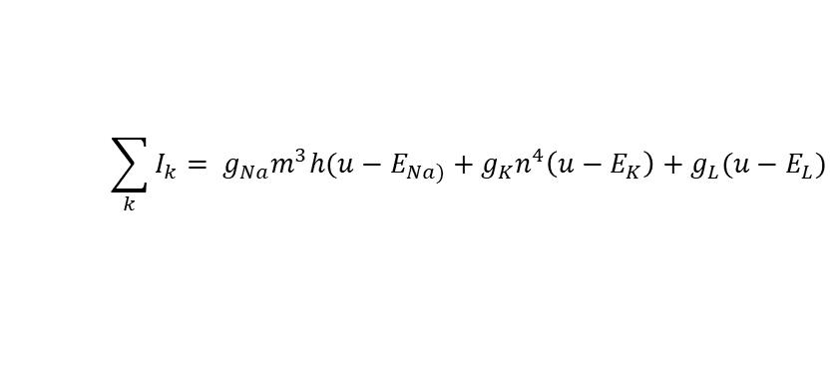
The HH model
K+ channels open
Na+ channels close
Restoration of the membrane potential; preparation for a new spike
Na+ flows in;
depolarization
m and n increase
h decreases
$$\sum_{k}{I_{k}= g_{Na}m^{3}h(u−E_{Na)}+g_{K}n^{4}\left(u−E_{K}\right)+g_{L}(u−E_{L})}$$
Accurately models action potentials using ion channel dynamics.
Gating variables control the state of the ion channels.
m: opening of sodium channels
h: blocking of sodium channels
n: opening of potassium channels

Slide 35
K+ channels open
Na+ channels close
Restoration of the membrane potential; preparation for a new spike
Na+ flows in;
depolarization
m and n increase
h decreases slowly
m: opening of sodium channels
h: blocking of sodium channels
n: opening of potassium channels

Slide 36
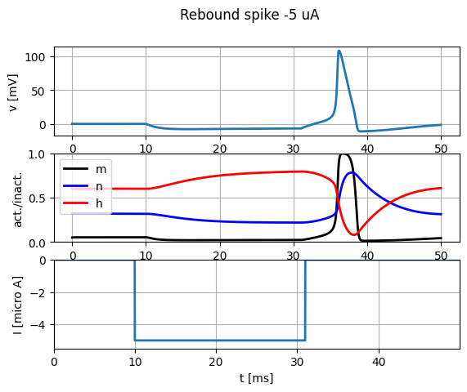
Upon hyperpolarization...
h increases, leaving more sodium channels for activation
m decreases
This increases the neuron’s excitability; when the hyperpolarizing current ends a spike is generated.
m: opening of sodium channels
h: blocking of sodium channels
n: opening of potassium channels

Slide 37
Type I and Type II neuron models
00

Slide 38
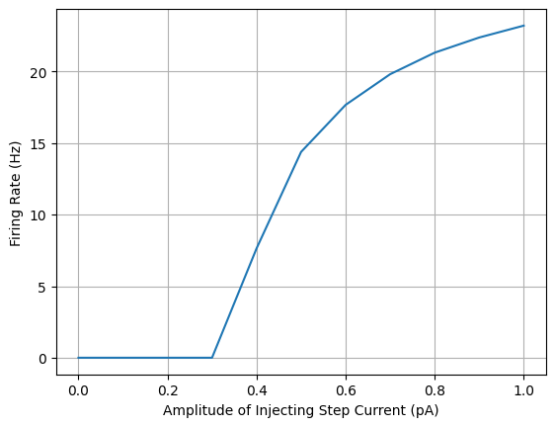
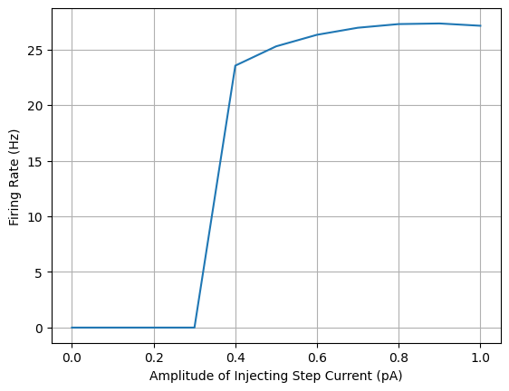
Type I
After injecting a constant stimulus, the u-nullcline shifts upwards. The ruins of the fixed point remain; flow remains slow in that area. Therefore, the frequency of the limit cycle is small at the bifurcation point and we obtain a continuous FI curve.
Type II

Slide 39
Network models

Slide 40
Oja’s learning rule
00

Slide 41
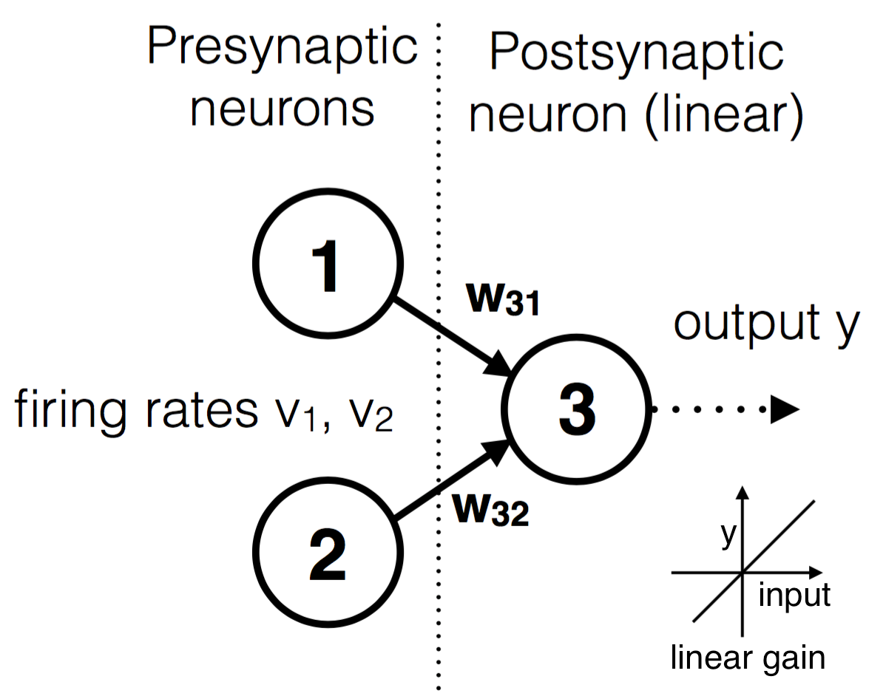
Oja’s learning rule
Neurons that fire together, wire together
For each new input, the weights change slightly according to Oja’s learning rule based on the firing rates

Slide 42
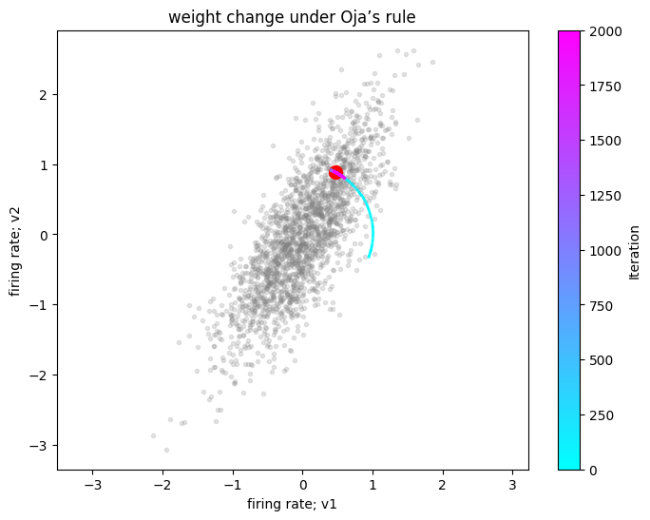
Oja’s learning rule
Neurons that fire together, wire together
For each new input, the weights change slightly according to Oja’s learning rule based on their firing rates
Finally, the weight vector moves toward the direction with the highest variance; towards the most informative features

Slide 43
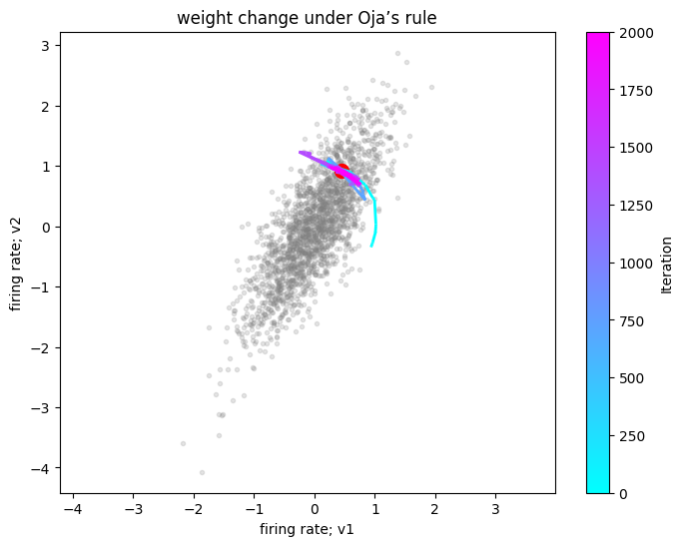
High learning rate
Low learning rate

Slide 44
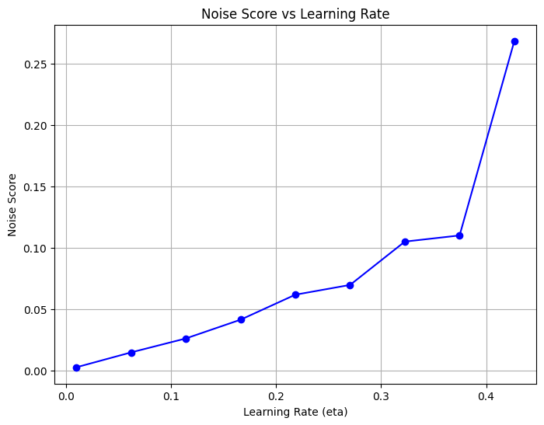

Slide 45
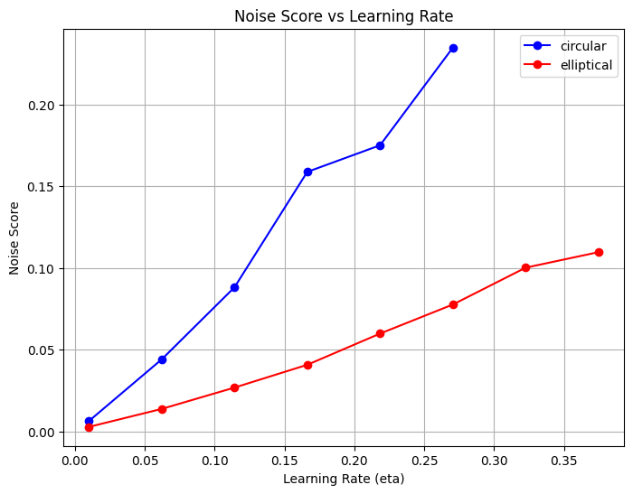

Slide 46


Slide 47
Network of LIF neurons
05

Slide 48

Network of LIF neurons
An excitatory population of LIF neurons is coupled to an inhibitory population
Both populations also receive external input from a homogeneous Poisson process
Network structure.

Slide 49

Synchronicity
Synchronous pattern forms
Rhythmic oscillations
Alignment
Notes:
This figure consists of three panels showing neural activity in a simulated spiking network over 50 ms. It provides insights into how neurons fire over time, how population activity evolves, and how individual neurons' membrane potentials change.
- Shows AP of neuron; we see a synchronous pattern forming
The network starts with low activity and then builds up rhythmic oscillations.
Vm of two neurons start to align

Slide 50
Spatial working memory
06

Slide 51


Spatial working memory
Network structure.
Ring structure
Compte, A. (2000). Synaptic Mechanisms and Network Dynamics Underlying Spatial Working Memory in a Cortical Network Model.
Cerebral Cortex, 10(9), 910-923. https://doi.org/10.1093/cercor/10.9.910

Slide 52

Bump formation
localized region of persistent neural activity
Activity bump forms around the stimulus location and is sustained
Ring structure
Notes:
A weak stimulus, centered at 120∘120∘, is applied to a subset of the excitatory population from t=200mst=200ms to t=400mst=400ms (blue box in top panel). This creates an activity bump in the excitatory subpopulation. The activity sustains after the end of the stimulation. The active neurons have a preferred direction close to the stimulus location.

Slide 53




Population vector Θ: Angle stored in working memory
Each neuron has a preferred direction
The neurons that spike more frequently contribute more to the computed orientation.
Population vector Θ as a function of time
Ring model of head direction cells: Neighbouring neurons excited each other while neurons at larger distances along the ring inhibit each other.
Notes:
The goal is to estimate θ(t), the angle stored in working memory, by calculating the weighted mean of the preferred orientations of neurons based on their spike counts.
- The population vector represents the mean orientation stored in memory.
- Each neuron has a preferred direction (e.g., some neurons prefer 0°, others prefer 90°, etc.).
- The neurons that spike more frequently contribute more to the computed orientation.
- We compute θ(t) by averaging the preferred directions of neurons, weighted by their spike counts.

Slide 54
Perceptual decision making
07

Slide 55


Perceptual Decision Making
Structure within the excitatory population.
Network structure.
Competition between neuronal pools
Wong, K.-F. & Wang, X.-J. A Recurrent Network Mechanism of Time Integration in Perceptual Decisions. J. Neurosci. 26, 1314–1328 (2006).

Slide 56



Left or right?
Input ‘right’ is high
The population receiving the stronger stimulus ’wins’ the competition!
Increases excitatory activation of right subpopulation
Excites the inhibitory population

Slide 57
In conclusion
What did we just see?
Easy hypothesis testing;
Fewer ethical concerns
Fewer technical limitations
Fewer costs
Simple IF models for spiking
More elaborate, spatial models of dendrites and axons
Literature implementation
The HH model
Network models (for cognition)
Integration of (pre-existing) datasets and collaboration
Understanding the fundamental principles of the brain
Control and reproducibility

Slide 58
Thank you for listening!
Any questions?

